Slide 1
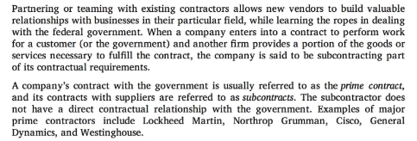
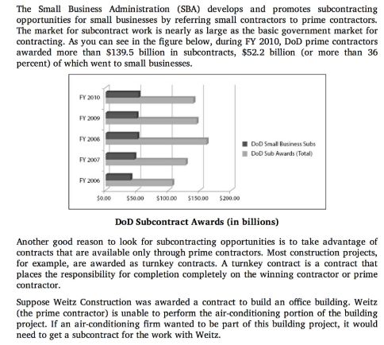
Subcontracting Opportunities

Slide 2
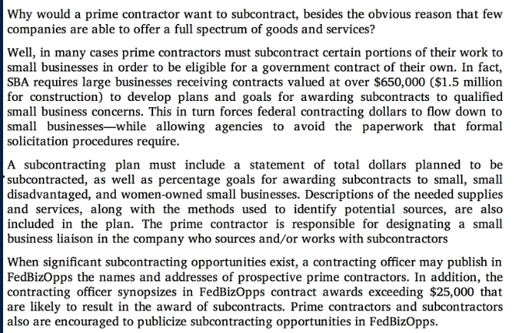
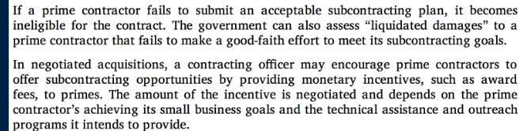
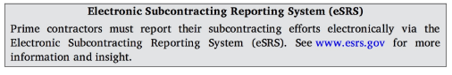
Subcontracting Plans

Slide 3
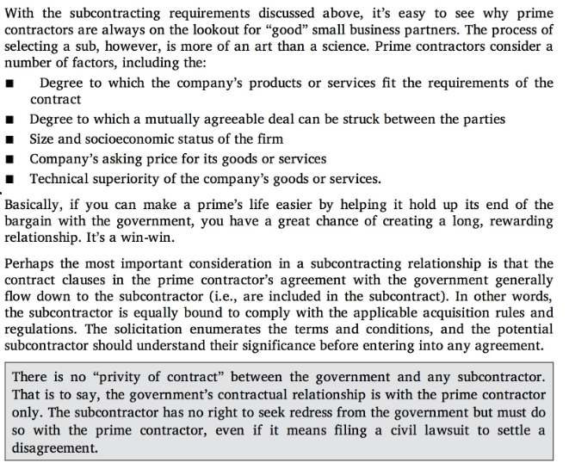
Selecting a Subcontractor

Slide 4
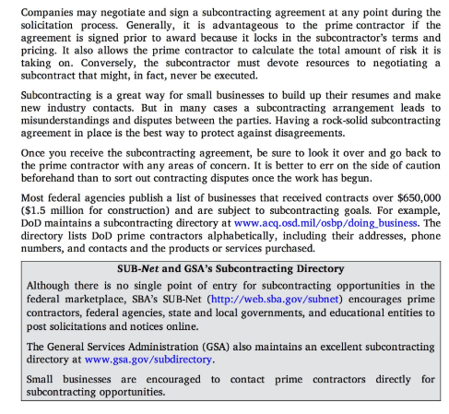
Awarding a Subcontract

Slide 5
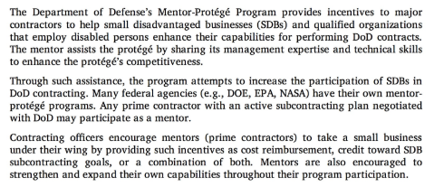
DOD Mentor Prote’ge’ Program

Slide 6

Prote’ge’ Qualifications

Slide 7

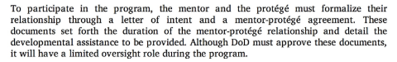
Finding a Mentor

Slide 8

Mentor Responsibilities

Slide 9
Steps to become a Subcontractor to a Prime Contractor

Slide 10
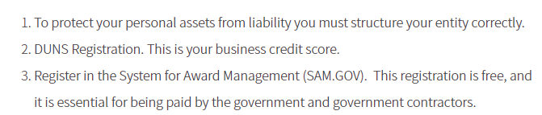
Step 1: Get Your Official Paperwork in Order

Slide 11
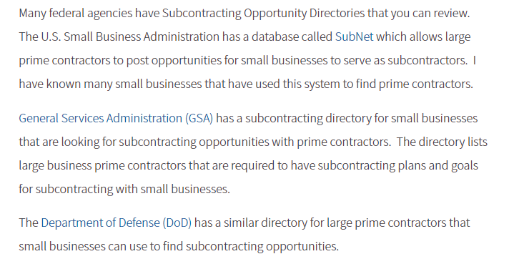
Step 2: Research Agencies and Prime Contractor for Subcontracting Needs

Slide 12
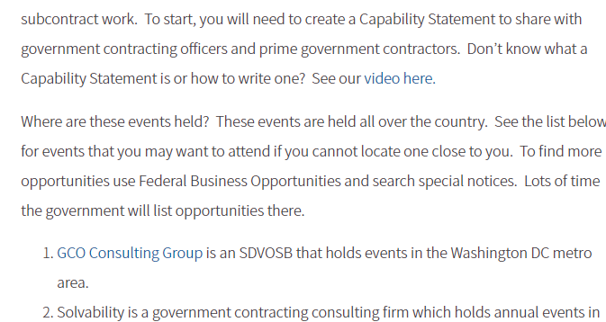
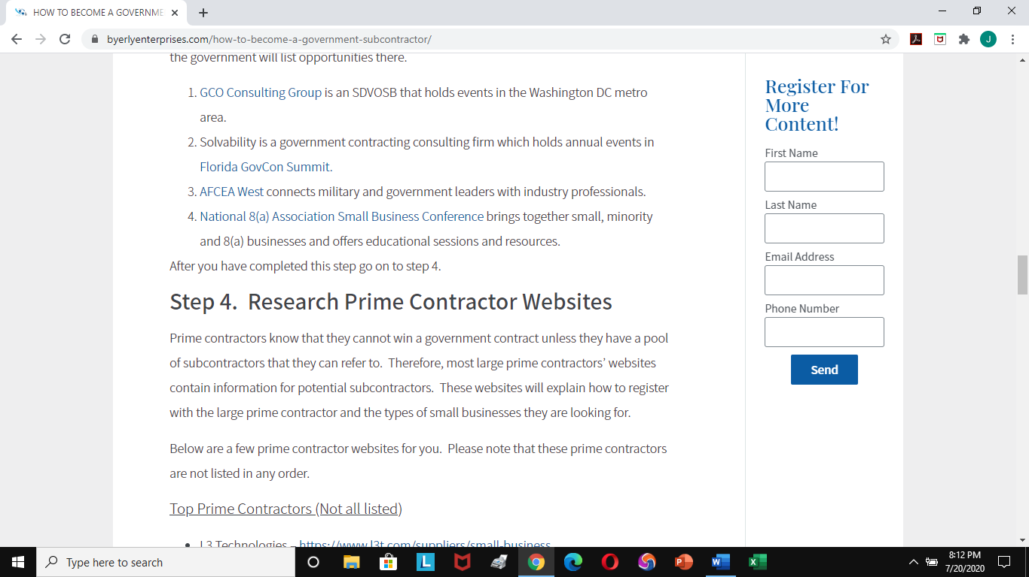
Step 3: Attend Outreach Events

Slide 13
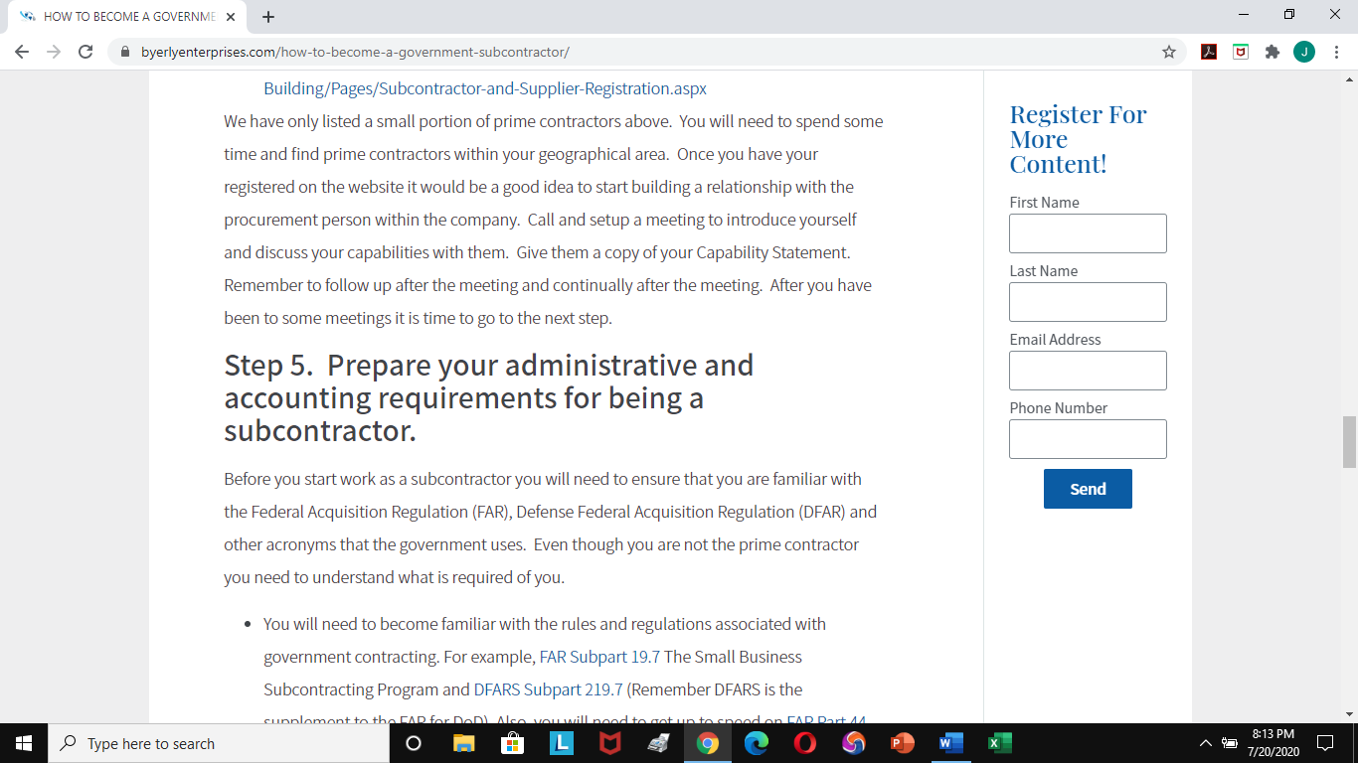
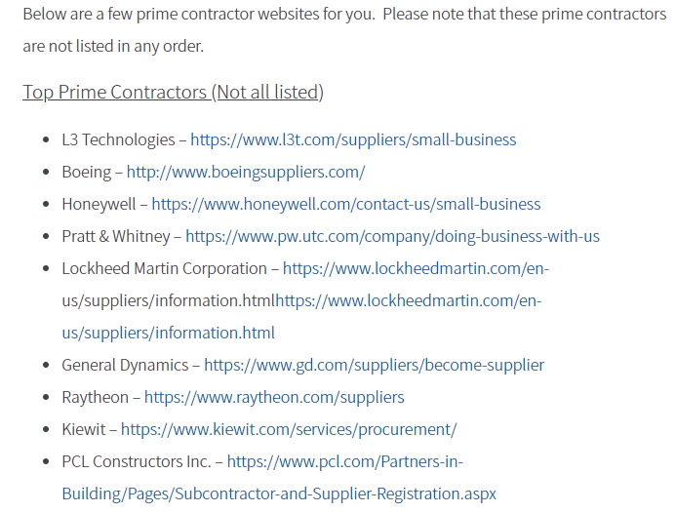
Step4: Research Prime Contractor Websites

Slide 14
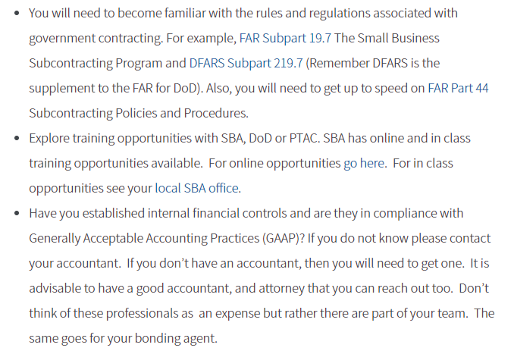
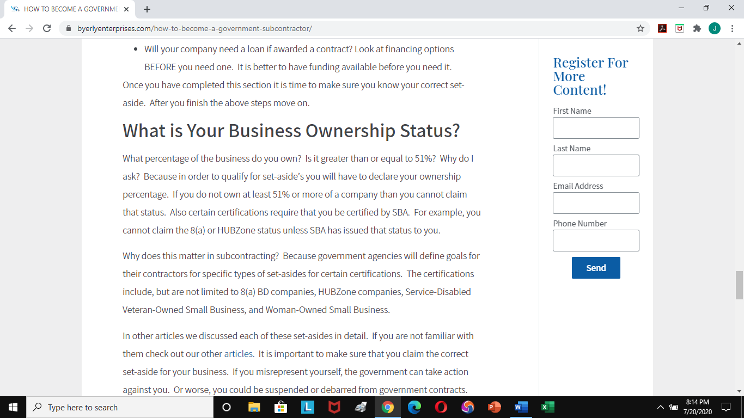
Step 5: Prepare Your Administrative & Accounting Requirements for Being a Subcontractor

Slide 15
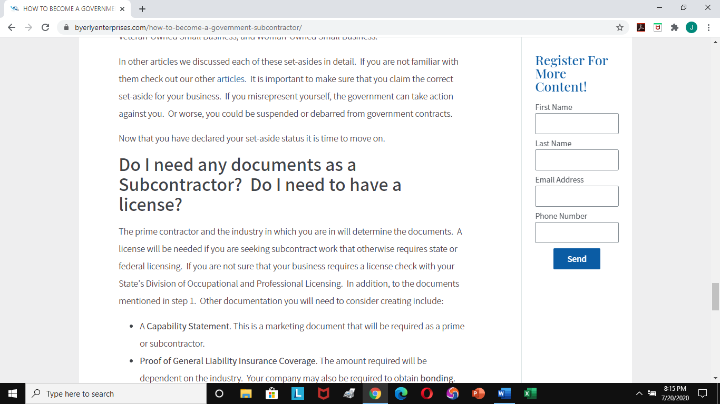
What is Your Business Ownership Status

Slide 16

Do I need any documents as a Subcontractor ?/Do I need a License

Slide 17
Small Business Financing

Slide 18
What is a Capabilities Statement
A capability statement is a concise, one page document of your business competencies.
Think of it as your business's resume.
Its purpose is to provide specific information that will convince potential customers to do business with you.
When written well, it will differentiate your business from the competition!

Slide 19
Capability Format
A capability statement should be very brief and specifically related to the needs of the agency you are targeting.
Preferably it is only one page, one side.
Go to two sides only if absolutely necessary.
Your Capability Statement should be a living document that will change depending on the targeted agency.
Develop a master copy that can be tailored to a government sector, project or sources sought notice as needed.
Save the document with your company's name in the file name.
Distribute your Capability Statement as a PDF, not in Word, PowerPoint or other format.
Many federal agencies block Word and Publisher documents; a PDF file is safer, usually smaller and will stay visually consistent when emailed.
You have limited space, so be sure to stress your competencies, set-aside eligibility and past performance

Slide 20
The Five Key Areas included in a Successful Effective Capability Statement are:
Core Competencies - this should not be everything your business is able to do. Use bullet points and short statements of your expertise as it relates to your target agency's specific needs.
Differentiators - list unique factors and benefits of your products or services that set you apart from the competition. How is your business best suited for the needs of the targeted agency? A clear statement that relates to the specific needs of the agency can help the customer understand why they should choose your firm.
Past Performance - list past customers for whom you have done similar work, show benefit to the customer and provide contact reference. Pictures are worth a thousand words and save space if relevant. If past projects do not relate to the targeted agency's needs, do not list them.
Company data - include one or two short sentences of your company description, including number of employees and capacity. Also list DUNS, CAGE Code, NAICS codes, and any set-aside eligibility that your business holds, such as Small Disadvantaged Business (SDB), Women-Owned Small Business (WOSB), 8(a) Certification, HUBZone, or Small Disadvantaged Veteran-Owned Small Business (SDVOSB).
Contact information - show contact information, including website and specific person's name. Readers will visit your website for more information; make sure it is constantly updated and provide "hot link" for direct access. List a professional email. Government agencies many times block Hotmail, Yahoo and Gmail accounts as junk mail. Your internet provider will typically offer professional addresses with your subscription.

Slide 21
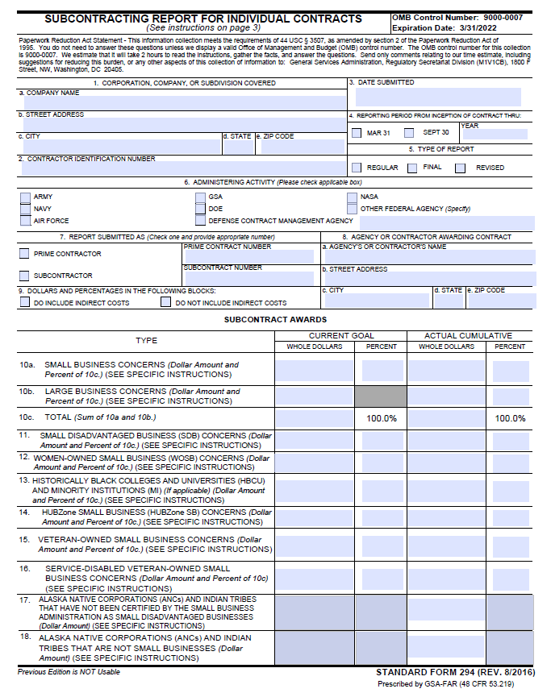
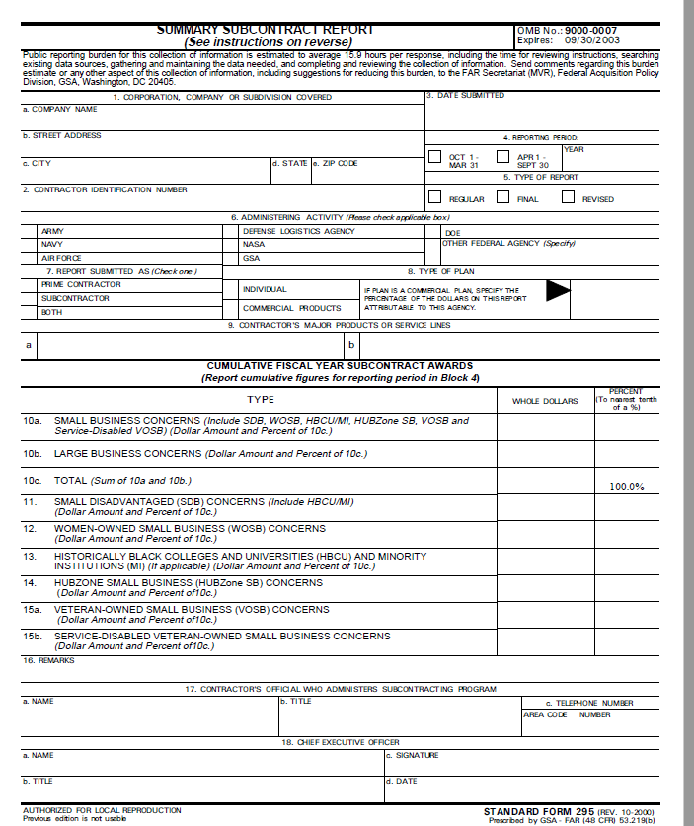
SF Forms 294 & 295

